Slide 1
Data Classification Methods
Andrew Wildman & Isaac Pang
Notes:
In the mentorship program this quarter, Andrew and I looked in to introducing me data science and into data classification methods.

Slide 2
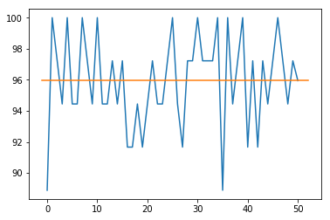
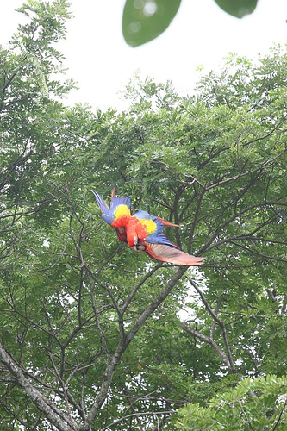
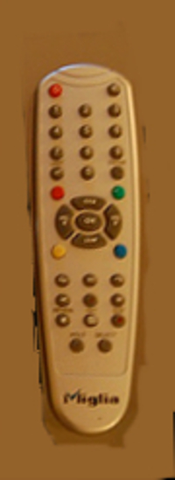
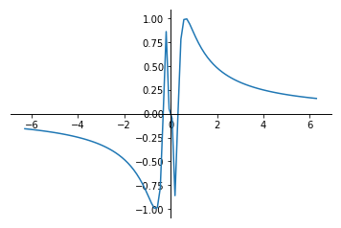
Introduction
Notes:
Why would someone be interested in data classification methods? It is used in artificial intelligence, where classification methods are used in things like Snapchat filters, or for Google Home. Andrew and I started out using Python packages to use the K-Nearest neighbors as a classification method to start to classify data.

Slide 3
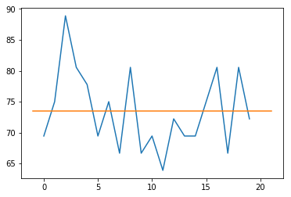
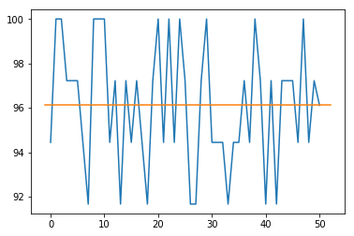
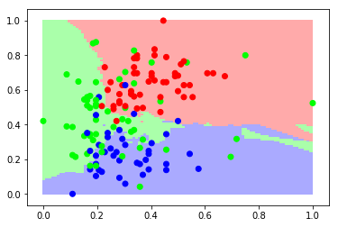
K-Nearest Neighbors for 2-Dimensions for Wine Dataset
KNN classification for 2 Dimensions
KNN classification for All Dimensions
Average accuracy: 73.472%
Average accuracy: 96.111%
KNN result for the 4th and 5th dimensions of wine dataset (88.889%)
Notes:
For this classification method, we used a wine dataset already in the scipy modules to test around with. Using two dimensions in the wine dataset, we classified the data with 10 nearest neighbors. The average accuracy result was about 73.742%. These results were inaccurate than as it would be compared to using all 13 dimensions of the given data, and 10 nearest neighbors, which produced a much higher accuracy. Because of its susceptibility to overfitting, we looked into a different method of classification.

Slide 4
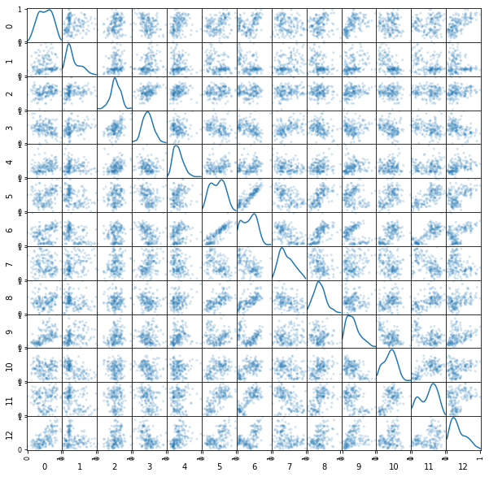
Decision Tree – Multidimensional Wine Set Data
Average Accuracy : 95.944%
Notes:
We looked into classifying with a decision tree, which splits up and categorizes the parts of the data that data points might appear, and for using all dimensions and 4 minimum sample leaves, this also gave results of good average accuracy. Now knowing the basics to methods of classification, we looked to classify some data that wasn’t restricted to just practice sets, and some real world data.

Slide 5
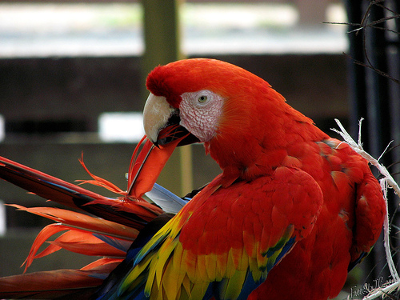
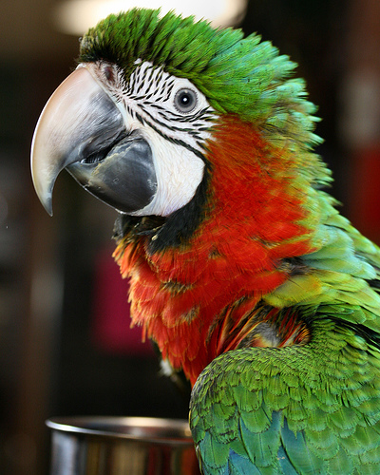
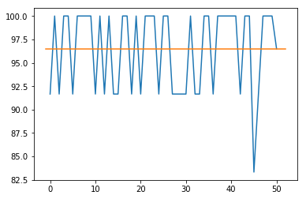
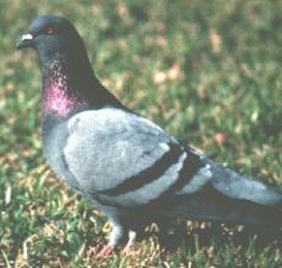
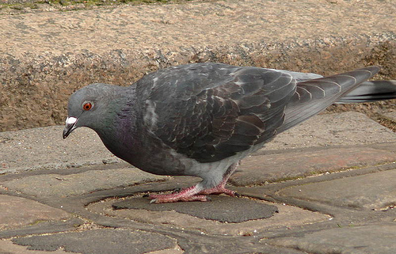
Decision Tree for Birds
30 samples of each macaws and pigeons
Average accuracy: 96.500%
Notes:
We used the decision tree on a set of birds, 30 of each macaws and rock pigeons, and results were highly accurate, averaging at around 96.5%. This is probably because of the high color contrast between these two birds and it was easier for these birds to be classified.

Slide 6
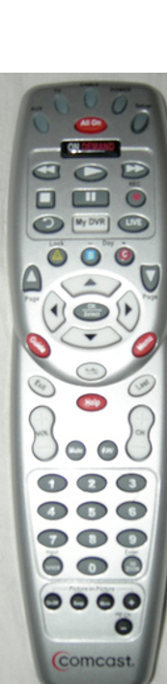
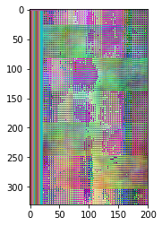
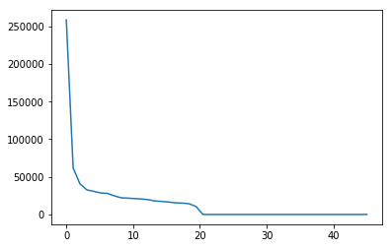
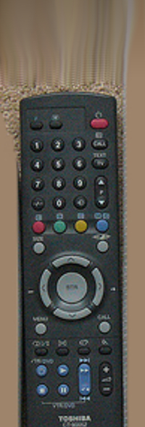
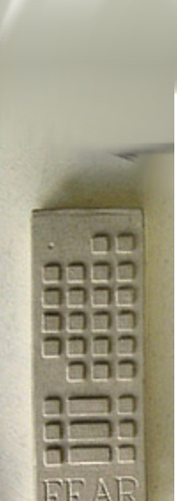
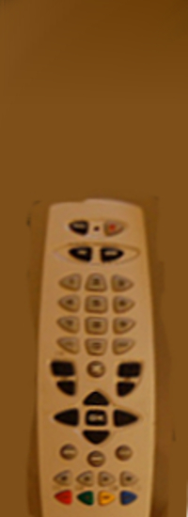
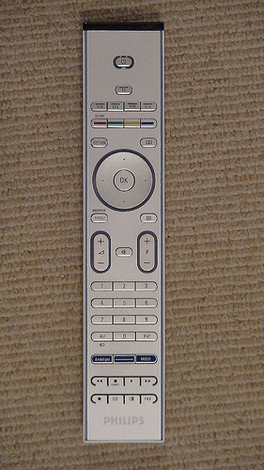
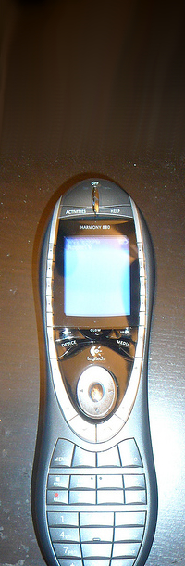
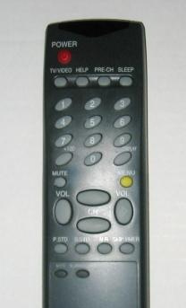
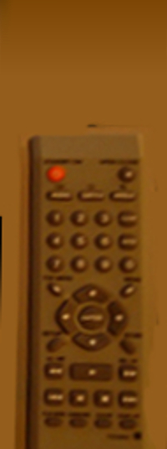
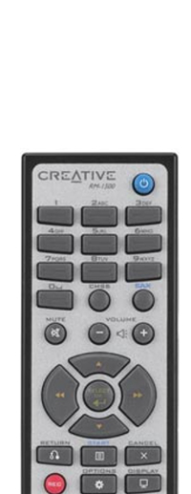
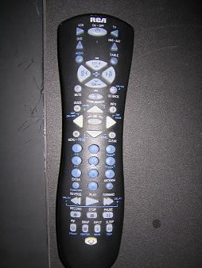
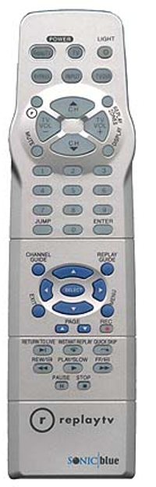

Singular Value Decomposition
45 samples
Notes:
We then played around with another method, singular value decomposition to try to find the average image for all remotes. However, the overall image for remotes [here] didn’t turn out well. This is perhaps because the remotes needed more data cleaning and not all remotes were same size and backgrounds; if those factors were the same, we could have gotten better results.

Slide 7
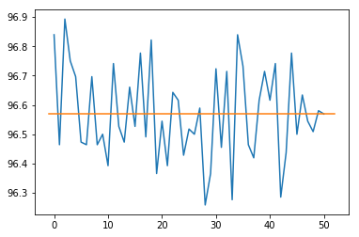
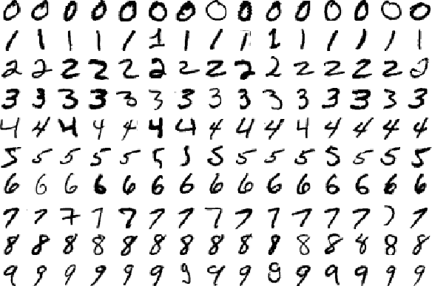
SVM Results with Mnist Dataset
Average accuracy: 96.569%
Chris J. C. Burges , Bernhard Schölkopf, Improving the accuracy and speed of support vector machines, Proceedings of the 9th International Conference on Neural Information Processing Systems, p.375-381, December 03-05, 1996, Denver, Colorado
Notes:
So we used data that was already cleaned enough and tried to use a SVM to classify hand-written digits. With the help of a report, we used an polynomial kernel to the 5th degree to optimize its speed and accuracy. And also, because this was such a big dataset, we ran in on Hyak and we got good results with an accuracy of 96.57

